Slide 1
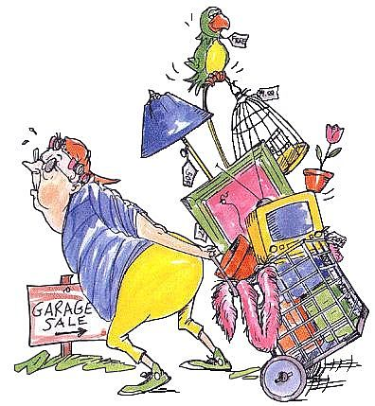
Unitmodule 23: Personal selling & Promotional skills for Hospitality

Slide 2
Part A

Slide 3
Promotion system:
+
+
=
product
positionering
persoonlijkheid
brand character

Slide 4
Product Life Cycle:

Slide 5
Advertising in Hospitality:

Slide 6
SALES PROMOTION in Hospitality:

Slide 9
PROMOTIONAL Activities: - 2 contrasting hospitality Business - for each item an evidence - Use subjects (yellow) of Task 1

Slide 10
Part B

Slide 11
Marketing MIX:

Slide 12
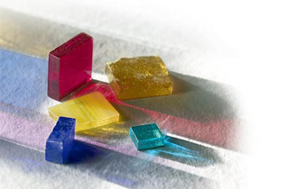
Lifestyle profielanalyse:
“MOSAIC” & “ACORN”

Slide 14
Guest groups / Profiles Activities: - Old Town Bar & Kitchen - Use the subjects (yellow) of Task 2, Task 3 3 and 4

Slide 15
Part C

Slide 16
De behoeften:
geld
ontplooiing
schoonheid
genegenheid
vrije tijd
hygiëne
lustgevoelens
gemak
gezondheid
zekerheid
waardering
bezitsdrang
acceptatie

Slide 17
Koopproces in beeld:

Slide 18
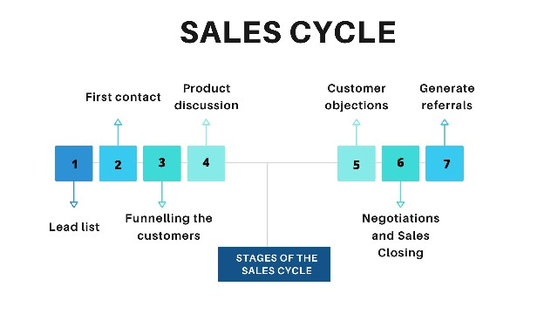
Types of Sale:
Single level direct sales are sales where you contact people individually. The examples of single-level direct sales are door-to-door selling, selling through catalogs, and selling through in-person presentations.
In multi-level direct sales, sales representatives are hired by companies to sell their products, or sometimes multi-level direct sales are made through business partners. Multi-level direct sales also take place on online platforms by selling through product catalogs or selling through social networking mediums.

Slide 19
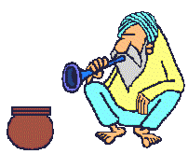
WIE BEN JE ?

Slide 20
Je eigenschappen:
Goede contactuele eigenschappen
Doorzettingsvermogen
Flexibiliteit
Enthousiasme
Overtuigingskracht
Inlevingsvermogen
Communicatieve vaardigheden
Positieve instelling
Initiatief tonen
Realiteitszin
Zelf inzicht en beheersing

Slide 21
Dus niet:
Hotel “de SLAPER”
Jannie Nederig
manager
sorry

Slide 22
WAT IS VERKOPEN?
IEMAND MEEHELPEN EEN
BESLISSING TE LATEN NEMEN

Slide 23
Maintains Hospitality Knowledge
· Understands the Market
· Understands the Company
· Knows Products and Services

Slide 24
Word of Mouth
Word of mouth
is communication about products and services between people who are perceived to be independent of the company that is producing or providing the product
a tool that works particularly well for the tourism and hospitality industry
Example: HILTON - “Come Home to HILTON”

Slide 25
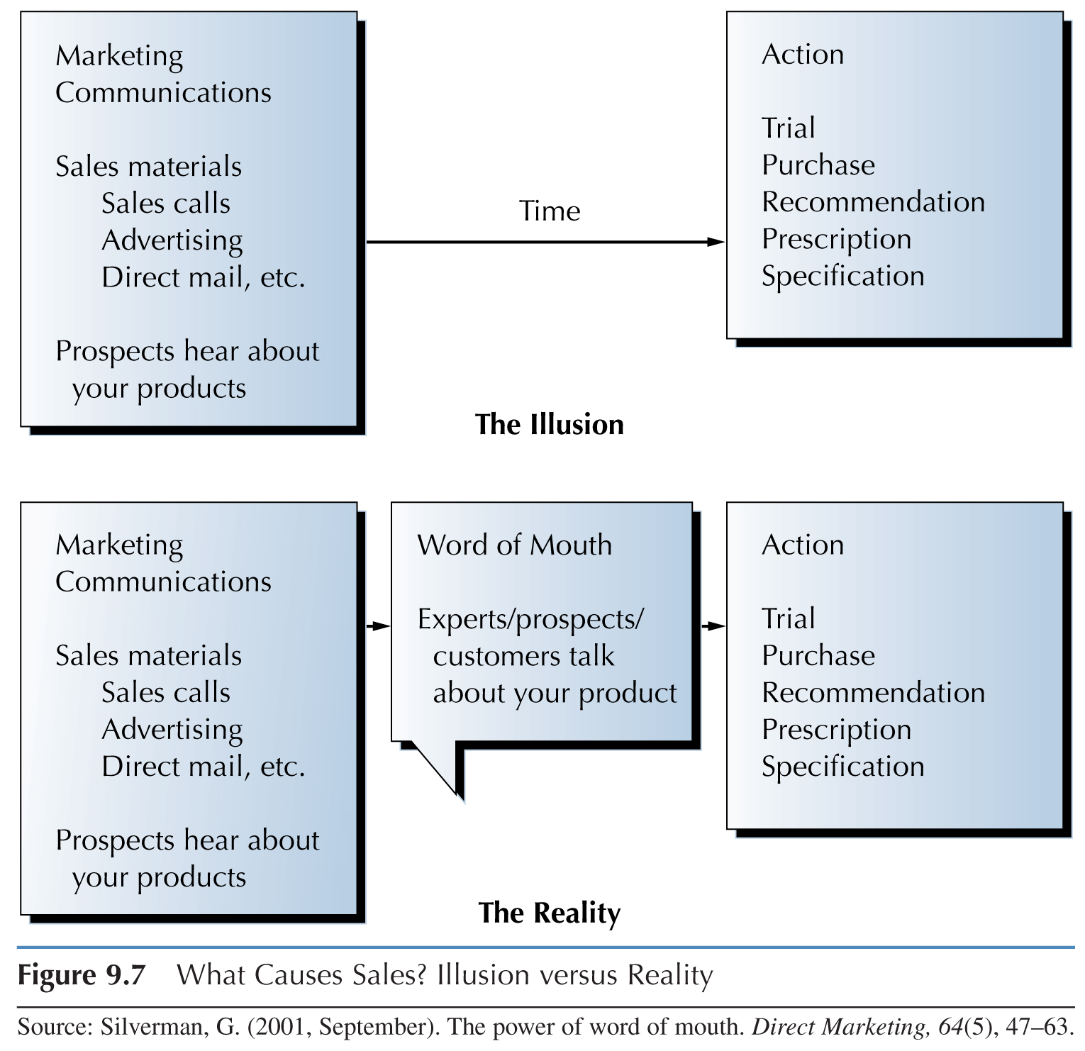
What Causes Sales?
Illusion versus Reality

Slide 26
Power of Word of Mouth
Independent credibility
Experience delivery
More relevant and complete
The most honest medium
Customer driven
It feeds on itself
Expert power
Experts like to influence
Saves time and money
Illusory force

Slide 27
Gespreksstructuur:
C = Contact leggen
O = Onderzoek
D = Doen
A = Afsluiting

Slide 28
Klantentypologie:
Dominante klant
Rationele klant
Emotionele klant
Experimentele klant

Slide 29
Personal Selling Formats
Cross-selling
offering a customer the opportunity to purchase allied products that go beyond the obvious core products

Slide 30
Personal Selling Formats
Up-selling
upgrading price and profit margins by selling higher-priced products
Second-chance selling
trying to sell additional services to a customer who has already booked services

Slide 31
Guest buying process + Own skills: - Process explanation + Evidence - Use the subjects (yellow) of Task 5
- Types of sales + Own skills
- Use the subjects (yellow)of Task 6
- Succesful selling for a Top host/hostess
- Use the subjects (yellow) of Task 7
- Witness statements

